Slide 1
ERASMUS+ PROGRAMME Erasmus+ - Key Action 2 Capacity Building in the Field of Higher Education
Project Number: 561708-EPP-1-2015-1-DE-EPPKA2-CBHE-JP
Vocational training center for undergraduate university students and teachers in Jordan (VTC)
P 8: BAU
BAU is a public university, established in 1997. It awards diploma, bachelor and master degrees in different fields of science, in BAU: 37531 students in 124 specialties in 19 colleges, 118564 graduates.

Slide 2
Preparation WP:
Website construction of the project on the BAU website and linked with the main website at JUST
Https://www.bau.edu.jo/conference/vtc/home.html
Establishing the VTC:
Equipped with 25 PCs, Printer, and smart board
2. Implementing the center

Slide 3
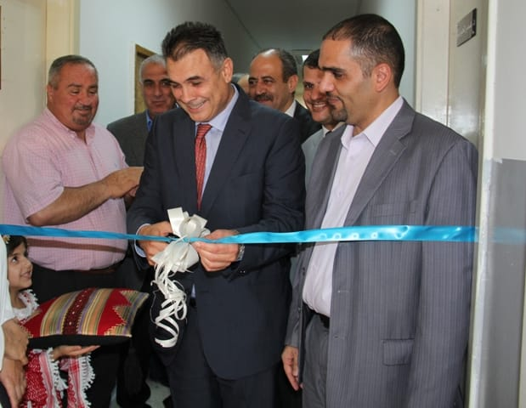
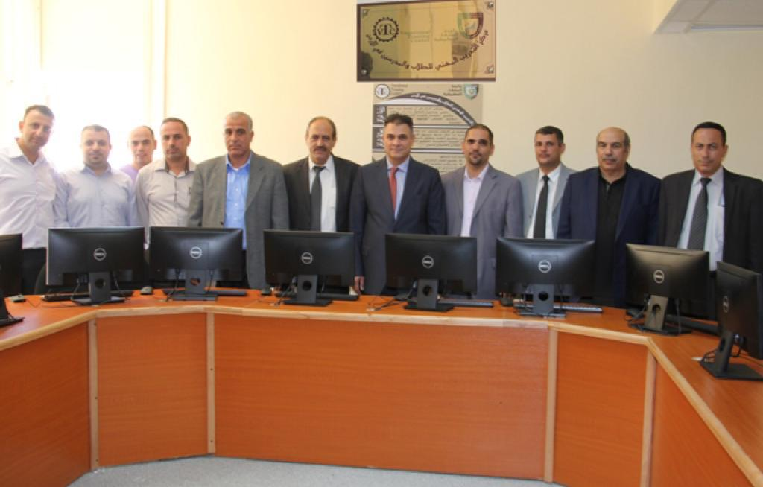
Implementing the center Aug, 2016

Slide 4
Development WP:
More than 6 training topics were selected for training students, each performed many times for different students by BAU trainers, number of trained students reached about 240
https://www.bau.edu.jo/conference/vtc/Training%20materials.html

Slide 5
The training topics:
Communication Skills and Self Management,
Writing a cv and preparing for a job interview,
E-learning, E-marketing (1&2),
Robotics & embedded systems and
Digital Educational Package

Slide 6
Students training by local trainers

Slide 7
Development WP:
Two training topics were conducted for teachers by BAU trainers, also each performed many times, and numbers of participants were about 155
The topics were: E-learning and Digital Educational Package
https://www.bau.edu.jo/conference/vtc/Training%20materials.html

Slide 8
For Teachers & students by local trainers

Slide 9
Four trainings were performed locally by EU trainers and the numbers of participants of staff were about 75 and of students were about 240
The topics are: History, Heritage and Development: The Touristic Activity, Sales and Marketing Skills: Strategy and Tactics and Customer Essential Elements of a Customer Management Approach

Slide 10
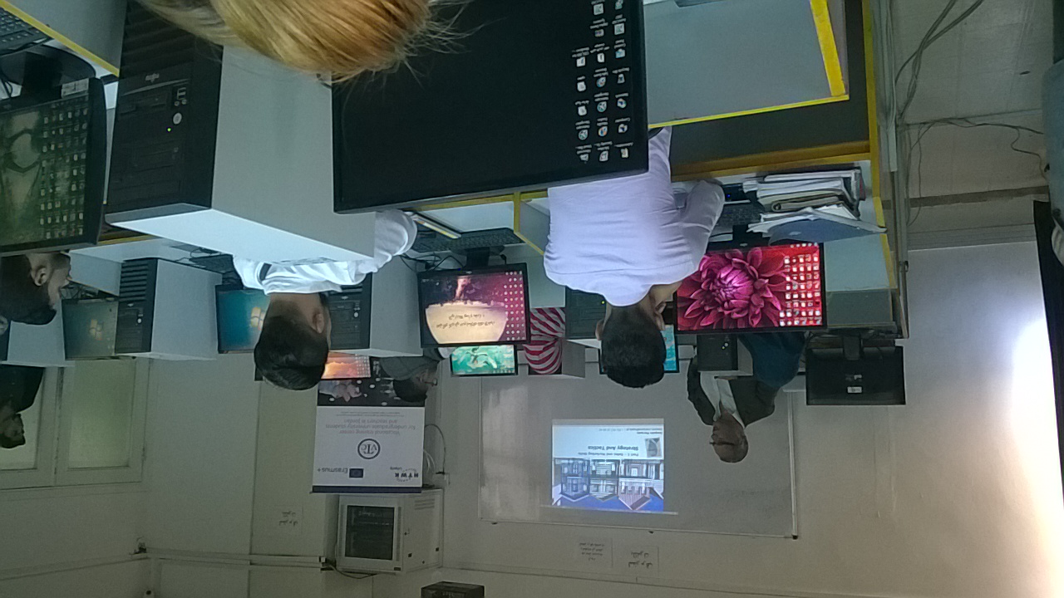
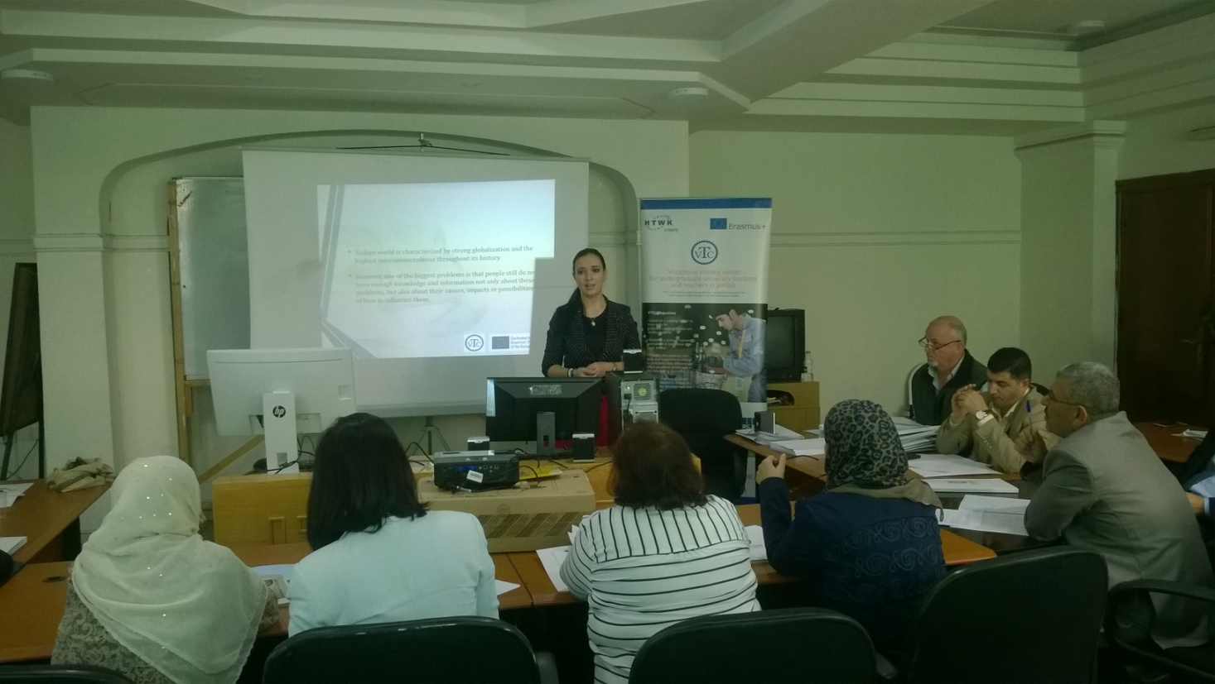
By EU trainers

Slide 11
Three training were performed in EU and the numbers of participants of BAU staff The topics are:
By Portuguese trainers: Concept of Quality, Concept of Quality/ Quality Management Systems, Concept of Qualitative Data Analysis Software, Customer Management and customer services, Sales and Marketing Skills, Modern strategies in Teaching and Digital Platforms in Teaching: Learning process framework and digital resources, 21 st Century skills students outcomes

Slide 12
By Slovak trainers: Management Facts and Figures, Interviews Through Digital Media and Critical Thinking in Solving Problems and New Ideas
By British trainers: Graduates Employability

Slide 13
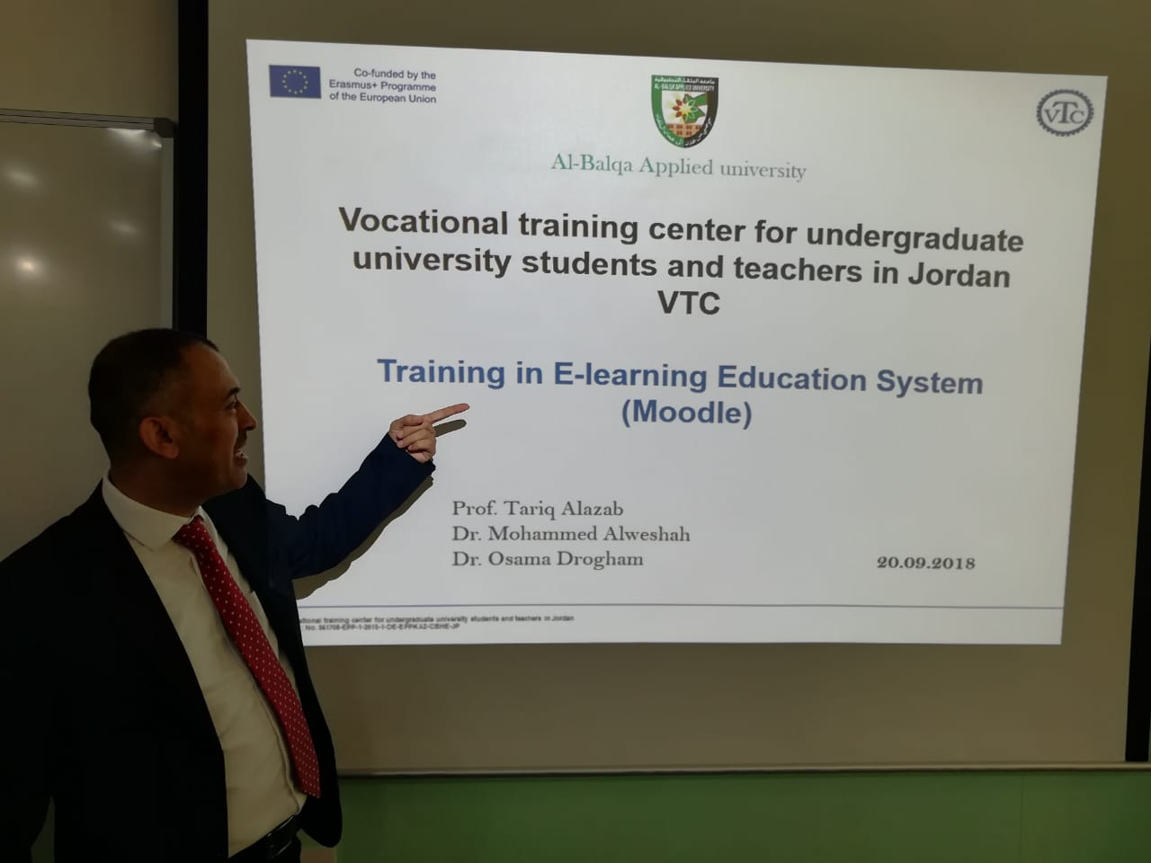
The forth topic are:
E-LEARNING USING MOODLE
A Learning portal –Using Moodle-
A teacher administrator has full control over all settings for a course, including restricting other teachers
Choice of course formats such as by week, by topic
Flexible array of course activities: Quizzes, Resources, Choices, Surveys, Assignments, Chats, Workshops
Display recent changes to the course since the last login can be displayed on the course home page
Import and export custom courses, examples, and scorn compatible objects

Slide 14
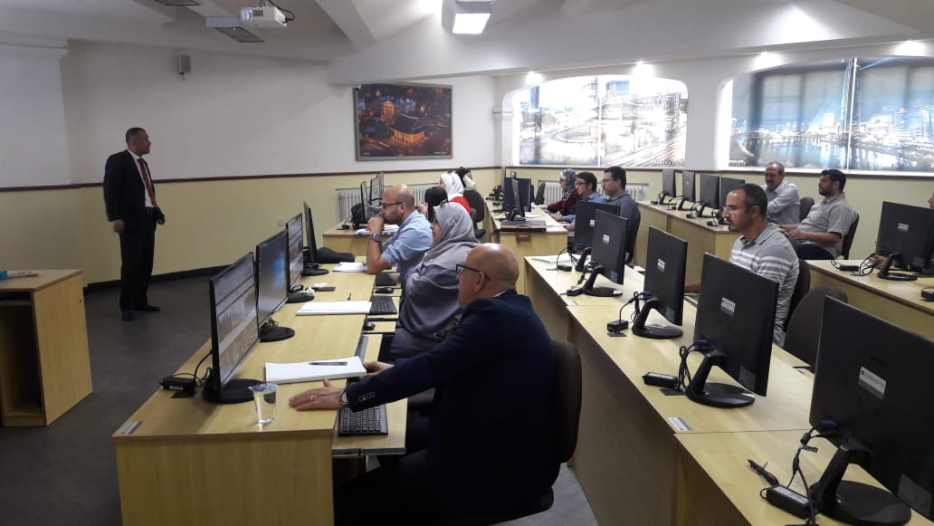
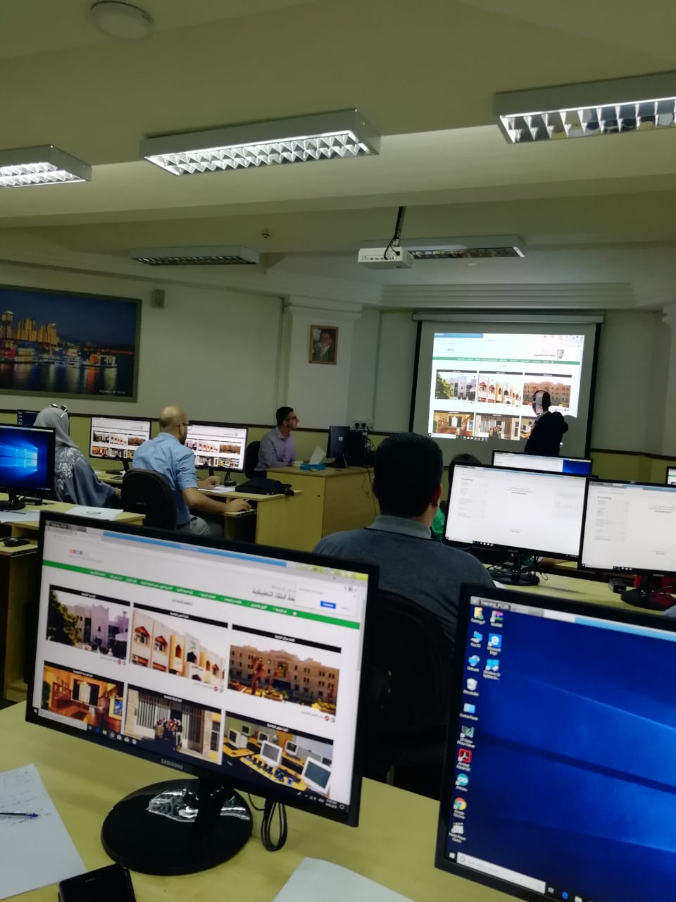
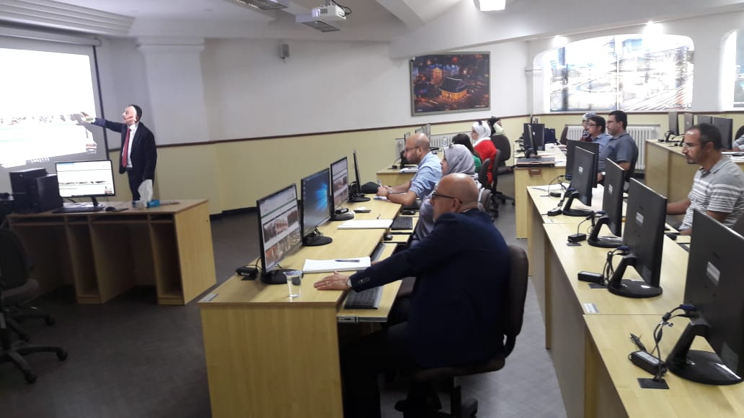

Slide 15
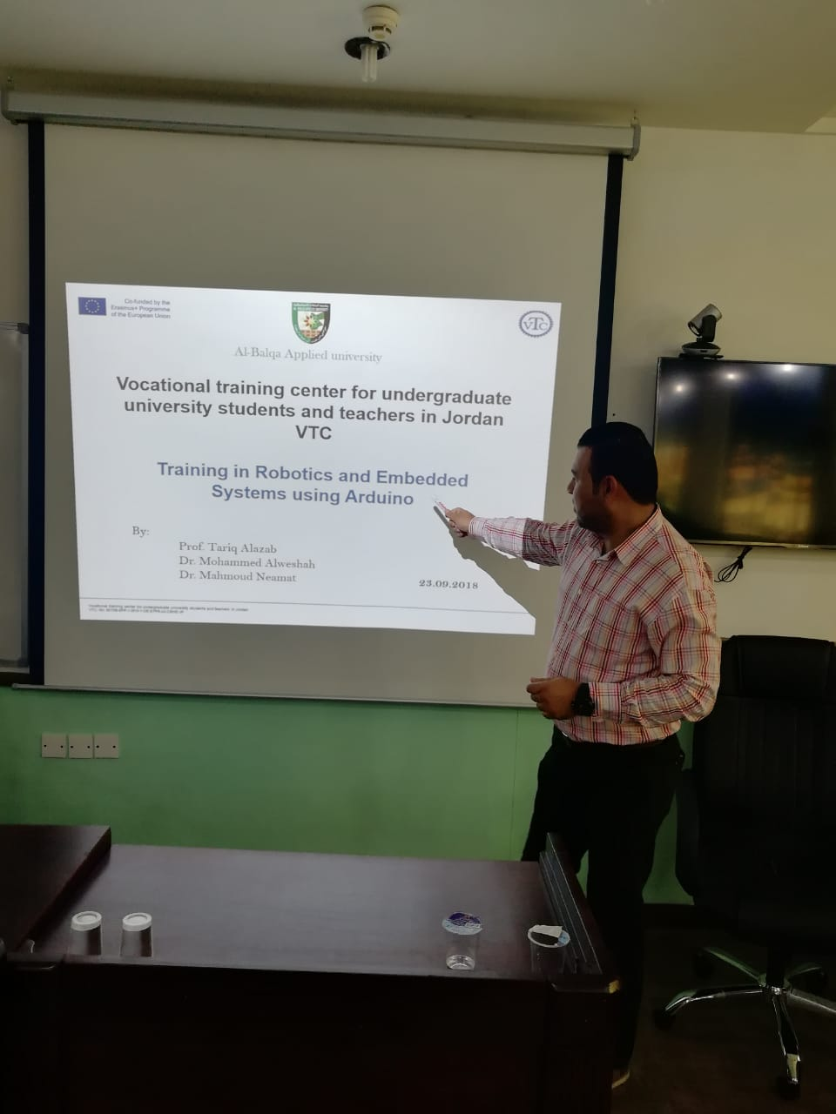
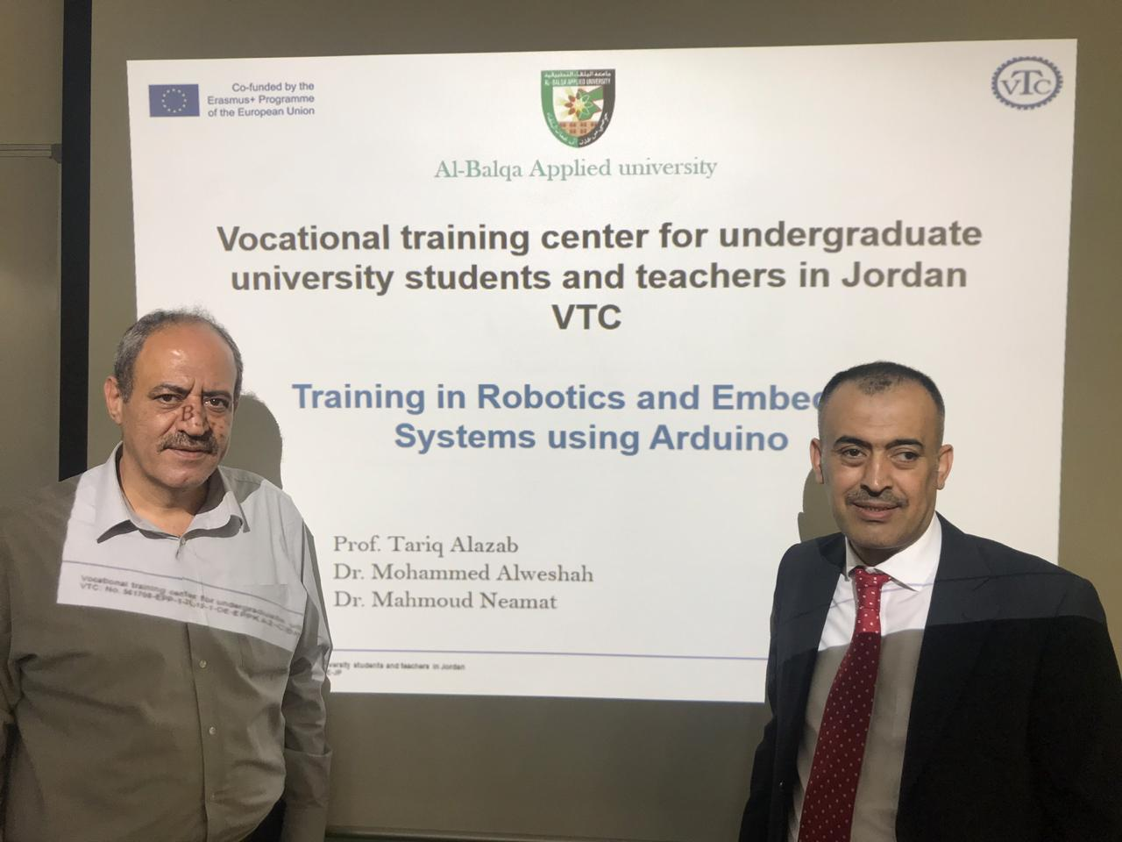
The fifth topic are:
Training in Robotics and Embedded Systems using Arduino

Slide 16
Dissemination
VTC Project website
- The first annual job fair was held on July 2017 in the presence of the Ministry of Work and also the private sector
- The second annual job fair was also held on April 2018 in the presence of the private sector
Through Social Media, Ex. Face book
Press material

